Slide 1
CS162 Operating Systems and Systems Programming Lecture 23 TCP/IP (Finished), Distributed Storage, Key-Value Stores
April 25th, 2016
Prof. Anthony D. Joseph
http://cs162.eecs.Berkeley.edu

Slide 2
Recall: Open Connection – 3-Way Handshaking
If it has enough resources, server calls accept() to accept connection, and sends back a SYN ACK packet containing
Client’s sequence number incremented by one, (x + 1)
Why is this needed?
A sequence number proposal, y, for first byte server will send
Client (initiator)
Server
Active Open
connect()
listen()
SYN, SeqNum = x
Passive Open
accept()
SYN and ACK, SeqNum = y and ACK = x + 1
time
ACK, ACK = y + 1
allocate buffer space

Slide 3
3-Way Handshaking (cont’d)
Three-way handshake adds 1 RTT delay
Why do it this way?
Congestion control: SYN (40 byte) acts as cheap probe
Protects against delayed packets from a previous connection (would confuse receiver)

Slide 4
Close Connection
Goal: both sides agree to close the connection
4-way connection tear down
Host 1
Host 2
close
FIN
FIN ACK
data
FIN
close
FIN ACK
closed
Can retransmit FIN ACK if it is lost
timeout
closed

Slide 5

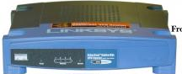
Network Address Translation (NAT)
Problem:
IPv4 supports 2³² hosts, but allocation classes mean not all addresses can practically be used
Stanford, MIT each have class A allocation: 16,777,216 addresses!
IPv6 deployment is going slowly
Solution – Network Address Translation
Local subnet (uses non-routable IP addresses) ⇒ External IP
Router/firewall replaces local IP address/port combinations with external IP address/new port combinations
Router/firewall maintains translation table of current connections
Internet

Slide 6
Recall: Using TCP Sockets
Socket: an abstraction of a network I/O queue
Embodies one side of a communication channel
Same interface regardless of location of other end
Could be local machine (called “UNIX socket”) or remote machine (called “network socket”)
First introduced in 4.2 BSD UNIX: big innovation at time
Now most operating systems provide some notion of socket
Using Sockets for Client-Server (C/C++ interface):
On server: set up “server-socket”
Create socket, Bind to protocol (TCP), local address, port
Call listen(): tells server socket to accept incoming requests
Perform multiple accept() calls on socket to accept incoming connection request
Each successful accept() returns a new socket for a new connection; can pass this off to handler thread
On client:
Create socket, Bind to protocol (TCP), remote address, port
Perform connect() on socket to make connection
If connect() successful, have socket connected to server

Slide 7
Recall: Socket Setup over TCP/IP
Server
Socket
Request Connection
new
socket
socket
socket
connection
Client
Server
Things to remember:
Connection involves 5 values: [ Client Addr, Client Port, Server Addr, Server Port, Protocol ]
Often, Client Port “randomly” assigned
Server Port often “well known”
80 (web), 443 (secure web), 25 (sendmail), etc
Well-known ports from 0—1023
Network Address Translation (NAT) allows many internal connections (and/or hosts) with a single external IP address

Slide 8

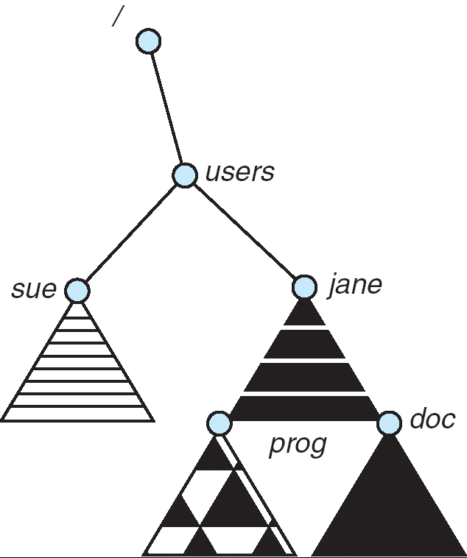
Distributed File Systems
Read File
Network
Data
Client
Server
Transparent access to files stored on a remote disk
Naming choices (always an issue):
Hostname:localname: Name files explicitly
No location or migration transparency
Mounting of remote file systems
Mounts remote file system by giving name and local mount point
Transparent to user: all reads and writes look like local reads and writes to user e.g. /users/sue/foo→/sue/foo on server
A single, global name space: every file in the world has unique name
Location Transparency: servers/files can move without involving user
mount
spot:/jane
mount
cory:/sue
mount
spot:/prog

Slide 9

Simple Distributed File System
Read (RPC)
Return (Data)
Client
Write (RPC)
Server
cache
ACK
Client
Remote Disk: Reads and writes forwarded to server
Use Remote Procedure Calls (RPC) to translate file system calls into remote requests
No local caching/can be caching at server-side
Advantage: Server provides completely consistent view of file system to multiple clients
Problems? Performance!
Going over network is slower than going to local memory
Lots of network traffic/not well pipelined
Server can be a bottleneck

Slide 10
Use of Caching to Reduce Network Load
Crash!
Crash!
read(f1)
→V1
Read (RPC)
cache
read(f1)→V1
read(f1)→V1
F1:V1
Return (Data)
read(f1)→V1
Client
Write (RPC)
Server
cache
F1:V1
ACK
F1:V2
cache
write(f1)
→OK
F1:V2
read(f1)→V2
Client
Idea: Use caching to reduce network load
In practice: use buffer cache at source and destination
Advantage: if open/read/write/close can be done locally, don’t need to do any network traffic…fast!
Problems:
Failure:
Client caches have data not committed at server
Cache consistency!
Client caches not consistent with server/each other

Slide 11
Failures
Crash!
What if server crashes? Can client wait until server comes back up and continue as before?
Any data in server memory but not on disk can be lost
Shared state across RPC: What if server crashes after seek? Then, when client does “read”, it will fail
Message retries: suppose server crashes after it does UNIX “rm foo”, but before acknowledgment?
Message system will retry: send it again
How does it know not to delete it again? (could solve with two-phase commit protocol, but NFS takes a more ad hoc approach)
Stateless protocol: A protocol in which all information required to process a request is passed with request
Server keeps no state about client, except as hints to help improve performance (e.g., a cache)
Thus, if server crashes and restarted, requests can continue where left off (in many cases)
What if client crashes?
Might lose modified data in client cache

Slide 12
Network File System (NFS)
Three Layers for NFS system
UNIX filesystem API: open, read, write, close calls + file descriptors
VFS layer: distinguishes local from remote files
Calls the NFS protocol procedures for remote requests
NFS service layer: bottom layer of the architecture
Implements the NFS protocol
NFS Protocol: RPC for file operations on server
Reading/searching a directory
Manipulating links and directories
Accessing file attributes/reading and writing files
Write-through caching: Modified data committed to server’s disk before results are returned to the client
Lose some of the advantages of caching
Time to perform write() can be long
Need some mechanism for readers to eventually notice changes! (more on this later)

Slide 13
NFS Continued
NFS servers are stateless; each request provides all arguments require for execution
E.g. reads include information for entire operation, such as ReadAt(inumber,position), not Read(openfile)
No need to perform network open() or close() on file – each operation stands on its own
Idempotent: Performing requests multiple times has same effect as performing it exactly once
Example: Server crashes between disk I/O and message send, client resend read, server does operation again
Example: Read and write file blocks: just re-read or re-write file block – no side effects
Example: What about “remove”? NFS does operation twice and second time returns an advisory error

Slide 14
NFS Failure Model
Transparent to client system
Is this a good idea? What if you are in the middle of reading a file and server crashes?
Options – NFS provides both choices:
Hang until server comes back up (next week?)
Return an error (of course, most applications don’t know they are talking over a network)

Slide 15
NFS Cache Consistency
NFS protocol: weak consistency
Client polls server periodically to check for changes
Polls server for changes to data in last 3-30 seconds (tunable parameter)
Thus, when file is changed on one client, server is notified, but other clients use old version of file until timeout
What if multiple clients write to same file?
In NFS, can get either version (or parts of both)
Completely arbitrary
cache
F1 still ok?
F1:V2
F1:V1
No: (F1:V2)
Client
Write (RPC)
Server
cache
ACK
F1:V2
cache
F1:V2
Client

Slide 16
Sequential Ordering Constraints
What sort of cache coherence might we expect?
One CPU changes file, and before it’s done, another CPU reads file
Example: Start with file contents = “A”
What would we actually want?
Assume we want distributed system to behave exactly the same as if all processes are running on single system
If read finishes before write starts, get old copy
If read starts after write finishes, get new copy
Otherwise, get either new or old copy
For NFS:
If read starts more than 30 seconds after write, get new copy; otherwise, could get partial update
Client 1:
Read: gets A
Write B
Read: parts of B or C
Client 2:
Read: gets A or B
Write C
Client 3:
Read: parts of B or C
Time

Slide 17
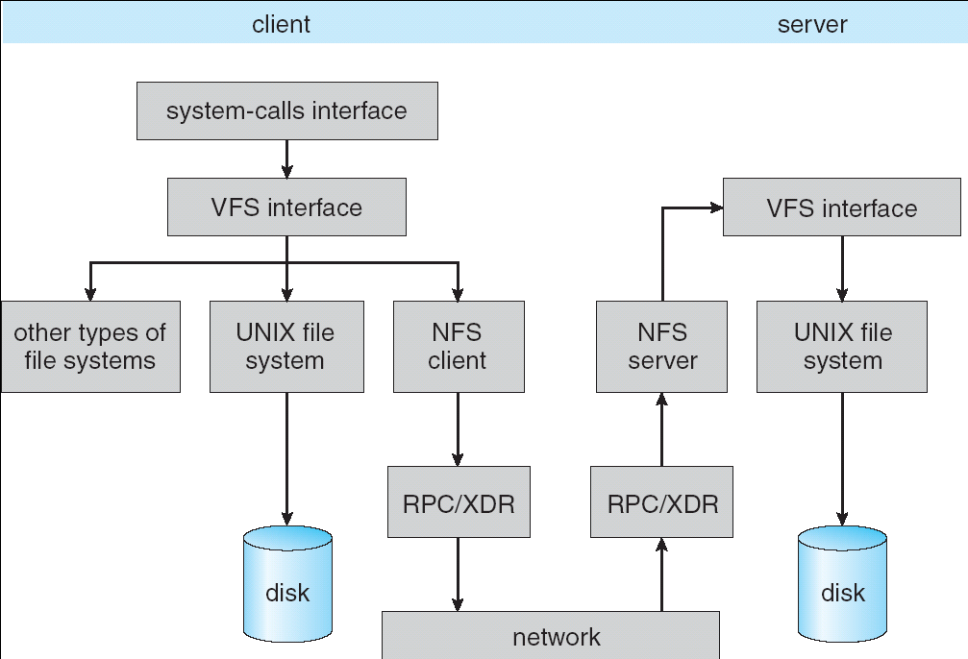
Implementation of NFS

Slide 18
NFS Pros and Cons
NFS Pros:
Simple, Highly portable
NFS Cons:
Sometimes inconsistent!
Doesn’t scale to large numbers of clients
Must keep checking to see if caches out of date
Server becomes bottleneck due to polling traffic

Slide 19
Andrew File System
Andrew File System (AFS, late 80’s) → DCE DFS (commercial product)
Callbacks: Server records who has copy of file
On changes, server immediately tells all with old copy
No polling bandwidth (continuous checking) needed
Write through on close
Changes not propagated to server until close()
Session semantics: updates visible to other clients only after file is closed
As a result, do not get partial writes: all or nothing!
Although, for processes on local machine, updates visible immediately to other programs who have file open
In AFS, everyone who has file open sees old version
Don’t get newer versions until reopen file

Slide 20
Andrew File System (con’t)
Data cached on local disk of client as well as memory
On open with a cache miss (file not on local disk):
Get file from server, set up callback with server
On write followed by close:
Send copy to server; tells all clients with copies to fetch new version from server on next open (using callbacks)
What if server crashes? Lose all callback state!
Reconstruct callback information from client: go ask everyone “who has which files cached?”
AFS Pro: Relative to NFS, less server load:
Disk as cache ⇒ more files can be cached locally
Callbacks ⇒ server not involved if file is read-only
For both AFS and NFS: central server is bottleneck!
Performance: all writes→server, cache misses→server
Availability: Server is single point of failure
Cost: server machine’s high cost relative to workstation

Slide 21
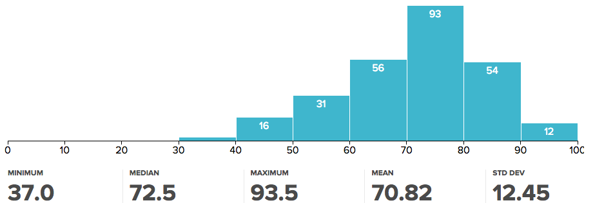
Administrivia
Midterm 2
Solutions have been posted
Will have until midweek (Wed 4/27 at 5pm) to submit regrade requests
Upcoming deadlines: HW4 due today (4/25), Project 3 due 5/3
Final exam: Monday May 9th 3-6 PM Wheeler Auditorium
Take Peer Reviews seriously!
We look carefully at your grades *and* comments!
Make sure to give us enough information to evaluate the group dynamic
Projects are a zero-sum game
If you don’t participate, you won’t get the same grade as your partners!
Your points can be given to your group members

Slide 22
break

Slide 23
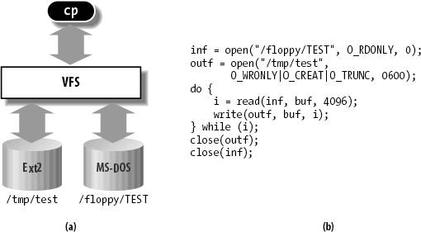
Enabling Factor: Virtual Filesystem (VFS)
VFS: Virtual abstraction similar to local file system
Provides virtual superblocks, inodes, files, etc
Compatible with a variety of local and remote file systems
Provides object-oriented way of implementing file systems
VFS allows the same system call interface (the API) to be used for different types of file systems
The API is to the VFS interface, rather than any specific type of file system
In linux, “VFS” stands for “Virtual Filesystem Switch”

Slide 24
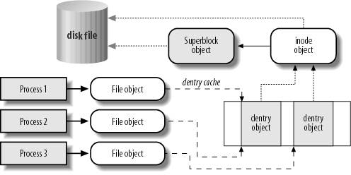
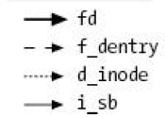
VFS Common File Model in Linux
Four primary object types for VFS:
superblock object: represents a specific mounted filesystem
inode object: represents a specific file
dentry object: represents a directory entry
file object: represents open file associated with process
There is no specific directory object (VFS treats directories as files)
May need to fit the model by faking it
Example: make it look like directories are files
Example: make it look like have inodes, superblocks, etc.

Slide 25
Linux VFS
write()
sys_write()
filesystem’s
write method
physical
media
user-space
VFS
filesystem
An operations object is contained within each primary object type to set operations of specific filesystems
“super_operations”: methods that kernel can invoke on a specific filesystem, i.e. write_inode() and sync_fs().
“inode_operations”: methods that kernel can invoke on a specific file, such as create() and link()
“dentry_operations”: methods that kernel can invoke on a specific directory entry, such as d_compare() or d_delete()
“file_operations”: methods that process can invoke on an open file, such as read() and write()
There are a lot of operations

Slide 26

Network-Attached Storage and the CAP Theorem
Network
Consistency:
Changes appear to everyone in the same serial order
Availability:
Can get a result at any time
Partition-Tolerance
System continues to work even when network becomes partitioned
Consistency, Availability, Partition-Tolerance (CAP) Theorem: Cannot have all three at same time
Otherwise known as “Brewer’s Theorem”

Slide 27
Key Value Storage
Handle huge volumes of data, e.g., PetaBytes!
Store (key, value) tuples
Simple interface
put(key, value); // insert/write “value” associated with “key”
value = get(key); // get/read data associated with “key”
Used sometimes as a simpler but more scalable “database”

Slide 28





Key Values: Examples
Amazon:
Key: customerID
Value: customer profile (e.g., buying history, credit card, ..)
Facebook, Twitter:
Key: UserID
Value: user profile (e.g., posting history, photos, friends, …)
iCloud/iTunes:
Key: Movie/song name
Value: Movie, Song

Slide 29
Key-Value Storage Systems in Real Life
Amazon
DynamoDB: internal key value store used for Amazon.com (shopping cart)
Simple Storage System (S3)
BigTable/HBase/Hypertable: distributed, scalable data storage
Cassandra: “distributed data management system” (developed by Facebook)
Memcached: in-memory key-value store for small chunks of arbitrary data (strings, objects)
BitTorrent distributed file location: peer-to-peer sharing system
…

Slide 30
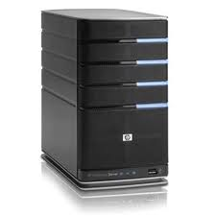
Key Value Store
Also called Distributed Hash Tables (DHT)
Main idea: partition set of key-values across many machines
key, value
…

Slide 31
Challenges
…
Fault Tolerance: handle machine failures without losing data and without degradation in performance
Scalability:
Need to scale to thousands of machines
Need to allow easy addition of new machines
Consistency: maintain data consistency in face of node failures and message losses
Heterogeneity (if deployed as peer-to-peer systems):
Latency: 1ms to 1000ms
Bandwidth: 32Kb/s to 100Mb/s

Slide 32
Key Questions
put(key, value): where to store a new (key, value) tuple?
get(key): where is the value associated with a given “key” stored?
And, do the above while providing
Fault Tolerance
Scalability
Consistency

Slide 33
Directory-Based Architecture
Have a node maintain the mapping between keys and the machines (nodes) that store the values associated with the keys
Master/Directory
put(K14, V14)
K5
N2
K14
N3
K105
N50
put(K14, V14)
K5
V5
K14
V14
K105
V105
…
N₁
N₂
N₃
N₅₀

Slide 34
Directory-Based Architecture
Have a node maintain the mapping between keys and the machines (nodes) that store the values associated with the keys
Master/Directory
get(K14)
K5
N2
V14
K14
N3
K105
N50
get(K14)
V14
K5
V5
K14
V14
K105
V105
…
N₁
N₂
N₃
N₅₀

Slide 35
Directory-Based Architecture
Having the master relay the requests → recursive query
Another method: iterative query (this slide)
Return node to requester and let requester contact node
Master/Directory
put(K14, V14)
K5
N2
N3
K14
N3
K105
N50
put(K14, V14)
K5
V5
K14
V14
K105
V105
…
N₁
N₂
N₃
N₅₀

Slide 36
Directory-Based Architecture
Having the master relay the requests → recursive query
Another method: iterative query
Return node to requester and let requester contact node
Master/Directory
get(K14)
N3
K5
N2
K14
N3
V14
K105
N50
get(K14)
K5
V5
K14
V14
K105
V105
…
N₁
N₂
N₃
N₅₀

Slide 37
Discussion: Iterative vs. Recursive Query
Master/Directory
Master/Directory
get(K14)
get(K14)
V14
K14
N3
N3
K14
N3
V14
get(K14)
get(K14)
Recursive
V14
Iterative
K14
V14
K14
V14
…
…
N1
N2
N3
N50
N1
N2
N3
N50
Recursive Query:
Advantages:
Faster, as typically master/directory closer to nodes
Easier to maintain consistency, as master/directory can serialize puts()/gets()
Disadvantages: scalability bottleneck, as all “Values” go through master/directory
Iterative Query
Advantages: more scalable
Disadvantages: slower, harder to enforce data consistency

Slide 38
Fault Tolerance
Replicate value on several nodes
Usually, place replicas on different racks in a datacenter to guard against rack failures
Master/Directory
put(K14, V14)
K5
N2
N1, N3
K14
N1,N3
K105
N50
put(K14, V14), N1
put(K14, V14)
K14
V14
K5
V5
K14
V14
K105
V105
…
N₁
N₂
N₃
N₅₀

Slide 39
Fault Tolerance
Again, we can have
Recursive replication (previous slide)
Iterative replication (this slide)
Master/Directory
put(K14, V14)
K5
N2
N1, N3
K14
N1,N3
K105
N50
put(K14, V14)
put(K14, V14)
K14
V14
K5
V5
K14
V14
K105
V105
…
N₁
N₂
N₃
N₅₀

Slide 40
Fault Tolerance
Or we can use recursive query and iterative replication…
Master/Directory
put(K14, V14)
K5
N2
K14
N1,N3
K105
N50
put(K14, V14)
put(K14, V14)
K14
V14
K5
V5
K14
V14
K105
V105
…
N₁
N₂
N₃
N₅₀

Slide 41
Scalability
More Storage: use more nodes
More Requests:
Can serve requests from all nodes on which a value is stored in parallel
Master can replicate a popular value on more nodes
Master/directory scalability:
Replicate it
Partition it, so different keys are served by different masters/directories
How do you partition?

Slide 42
Scalability: Load Balancing
Directory keeps track of the storage availability at each node
Preferentially insert new values on nodes with more storage available
What happens when a new node is added?
Cannot insert only new values on new node. Why?
Move values from the heavy loaded nodes to the new node
What happens when a node fails?
Need to replicate values from fail node to other nodes

Slide 43
Consistency
Need to make sure that a value is replicated correctly
How do you know a value has been replicated on every node?
Wait for acknowledgements from every node
What happens if a node fails during replication?
Pick another node and try again
What happens if a node is slow?
Slow down the entire put()? Pick another node?
In general, with multiple replicas
Slow puts and fast gets

Slide 44
Consistency (cont’d)
If concurrent updates (i.e., puts to same key) may need to make sure that updates happen in the same order
put(K14, V14’) and put(K14, V14’’) reach N1 & N3 in reverse order
What does get(K14) return?
Undefined!
Master/Directory
put(K14, V14’)
K5
N2
put(K14, V14’’)
K14
N1,N3
K105
N50
put(K14, V14’’)
put(K14, V14’)
put(K14, V14’')
put(K14, V14’)
K14
K14
V14
V14’
K5
V5
K14
K14
V14
V14’’
K105
V105
…
N₁
N₂
N₃
N₅₀

Slide 45
Large Variety of Consistency Models
Atomic consistency (linearizability): reads/writes (gets/puts) to replicas appear as if there was a single underlying replica (single system image)
Think “one updated at a time”
Transactions
Eventual consistency: given enough time all updates will propagate through the system
One of the weakest form of consistency; used by many systems in practice
Must eventually converge on single value/key (coherence)
And many others: causal consistency, sequential consistency, strong consistency, …

Slide 46
Quorum Consensus
Improve put() and get() operation performance
Define a replica set of size N
put() waits for acknowledgements from at least W replicas
get() waits for responses from at least R replicas
W+R > N
Why does it work?
There is at least one node that contains the update
Why might you use W+R > N+1?

Slide 47
Quorum Consensus Example
N=3, W=2, R=2
Replica set for K14: {N₁, N₃, N₄}
Assume put() on N₃ fails
put(K14, V14)
put(K14, V14)
put(K14, V14)
ACK
ACK
K14
V14
K14
V14
N₁
N₂
N₃
N₄

Slide 48
Quorum Consensus Example
Now, issuing get() to any two nodes out of three will return the answer
get(K14)
get(K14)
V14
NIL
K14
V14
K14
V14
N₁
N₂
N₃
N₄

Slide 49
Scaling Up Directory
Challenge:
Directory contains a number of entries equal to number of (key, value) tuples in the system
Can be tens or hundreds of billions of entries in the system!
Solution: consistent hashing
Associate to each node a unique id in an uni-dimensional space 0..2^{m}-1
Partition this space across m machines
Assume keys are in same uni-dimensional space
Each (Key, Value) is stored at the node with the smallest ID larger than Key

Slide 50
Key to Node Mapping Example
m = 6 → ID space: 0..63
Node 8 maps keys [5,8]
Node 15 maps keys [9,15]
Node 20 maps keys [16, 20]
…
Node 4 maps keys [59, 4]
63
0
4
58
8
14
V14
15
44
20
35
32

Slide 51
Lookup in Chord-like system (with Leaf Set)
Assign IDs to nodes
Map hash values to node with closest ID
Leaf set is successors and predecessors
All that’s needed for correctness
Routing table matches successively longer prefixes
Allows efficient lookups
Data Replication:
On leaf set
Source
111…
0…
110…
Response
10…
Lookup ID
Notes:
Each node is assigned an ID randomly
IDs are arranged into a ring by numerical order, top ID wraps around to 0
Each node maintains two sets of neighbors, its leaf set and routing table
Leaf set is immediate predecessor and successor
Routing table neighbors resolve successively longer matching prefixes of node’s own ID
Lookup queries are routed greedily to node with closest matching ID (numerically, not lexigraphically)
Response is sent directly to querying node
Lookup handled differently in other DHTs; see Gummadi et al.’s SIGCOMM paper for details

Slide 52
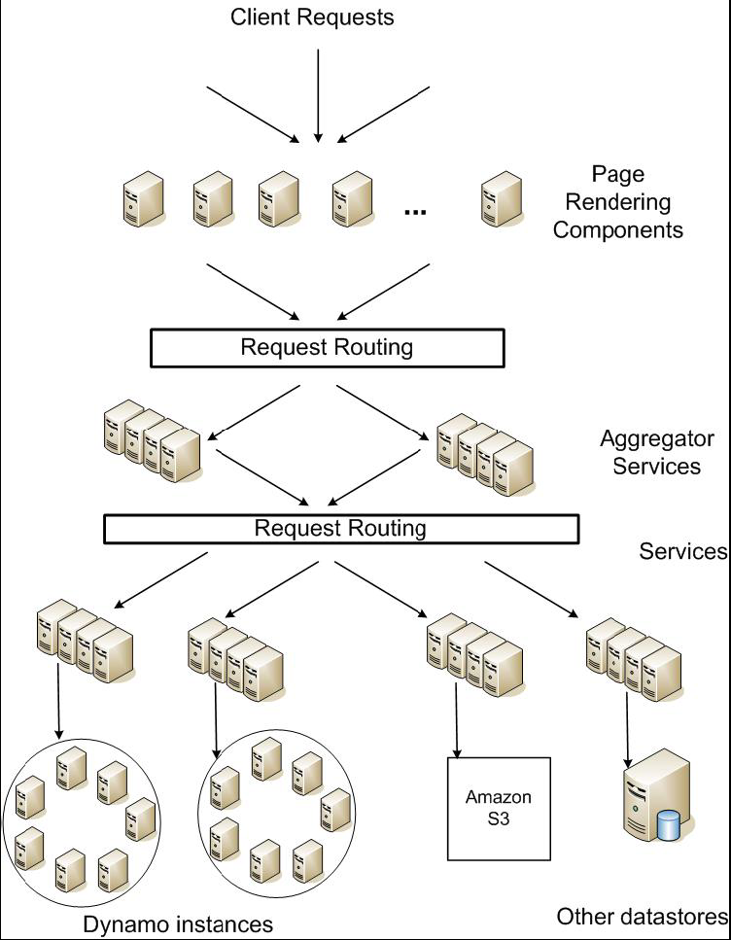
DynamoDB Example: Service Level Agreements (SLA)
Application can deliver its functionality in a bounded time:
Every dependency in the platform needs to deliver its functionality with even tighter bounds
Example: service guaranteeing that it will provide a response within 300ms for 99.9% of its requests for a peak client load of 500 requests per second
Contrast to services which focus on mean response time
Service-oriented architecture of Amazon’s platform

Slide 53
Summary (1/2)
Distributed File System:
Transparent access to files stored on a remote disk
Caching for performance
Cache Consistency: Keeping client caches consistent with one another
If multiple clients, some reading and some writing, how do stale cached copies get updated?
NFS: check periodically for changes
AFS: clients register callbacks to be notified by server of changes
Remote Procedure Call (RPC): Call procedure on remote machine
Provides same interface as procedure
Automatic packing and unpacking of arguments (in stub)

Slide 54
Summary (2/2)
VFS: Virtual File System layer
Provides mechanism which gives same system call interface for different types of file systems
Key-Value Store:
Two operations
put(key, value)
value = get(key)
Challenges
Fault Tolerance → replication
Scalability → serve get()’s in parallel; replicate/cache hot tuples
Consistency → quorum consensus to improve put() performance

Slide 55
Recall: RPC Information Flow
bundle
args
Client
(caller)
call
Client
Stub
send
Packet
Handler
return
receive
unbundle
ret vals
mbox2
Machine A
Network
Network
Machine B
bundle
ret vals
mbox1
Server
(callee)
return
Server
Stub
send
Packet
Handler
call
receive
unbundle
args

Slide 56
Recall: Distributed File System with Caching
read(f1)
→V1
Read (RPC)
cache
read(f1)→V1
read(f1)→V1
F1:V1
Return (Data)
read(f1)→V1
Client
Write (RPC)
Server
cache
F1:V1
ACK
F1:V2
cache
write(f1)
→OK
F1:V2
read(f1)→V2
Client
Transparent access to files stored on a remote disk
Use caching to reduce network load
In practice: use buffer cache at source and destination
Advantage: if open/read/write/close can be done locally, don’t need to do any network traffic…fast!
Problems:
Failure – Client caches have data not committed at server
Cache consistency – Client caches not consistent with server/each other

Slide 57
Recall: Sockets With Protection/Parallelism
Client
Server
Create Server Socket
Bind it to an Address
(host:port)
Create Client Socket
Connect it to server (host:port)
Listen for Connection
Accept connection
child
Connection Socket
Parent
Close Listen Socket
Close Connection Socket
write request
read request
read response
write response
Close Connection Socket
Wait for child
Close Client Socket
Close Server Socket

Slide 58
Recall: Client Protocol
char *hostname;
int sockfd, portno;
struct sockaddr_in serv_addr;
struct hostent *server;
server = buildServerAddr(&serv_addr, hostname, portno);
/* Create a TCP socket */
sockfd = socket(AF_INET, SOCK_STREAM, 0)
/* Connect to server on port */
connect(sockfd, (struct sockaddr *) &serv_addr, sizeof(serv_addr)
printf("Connected to %s:%d\n",server->h_name, portno);
/* Carry out Client-Server protocol */
client(sockfd);
/* Clean up on termination */
close(sockfd);

Slide 59
Recall: Server Protocol (v2)
/* Create Socket to receive requests*/
lstnsockfd = socket(AF_INET, SOCK_STREAM, 0);
/* Bind socket to port */
bind(lstnsockfd, (struct sockaddr)&serv_addr,sizeof(serv_addr));
/* Set up socket to listen for incoming connections */
listen(lstnsockfd, MAXQUEUE);
while (1) {
consockfd = accept(lstnsockfd, (struct sockaddr *) &cli_addr,
&clilen);
cpid = fork(); /* new process for connection */
if (cpid > 0) { /* parent process */
close(consockfd);
tcpid = wait(&cstatus);
} else if (cpid == 0) { /* child process */
close(lstnsockfd); /* let go of listen socket */
server(consockfd);
close(consockfd);
exit(EXIT_SUCCESS); /* exit child normally */
}
}
close(lstnsockfd);

